Slide 1

GROUP PROJECT
Graphical Representation of BFS, DFS & A* algorithm

Slide 2
Team Members
Samiksha Bhagat
Deep Sawarkar
Janavi Sadmake
Yuvraj Vaidya
Sarthak Bhokey

Slide 3
CONTENT
Problem Statement
Goal of Project
Technologies & Tools used
Implementation Approach
Breadth-First Search (BFS)
Depth-First Search (DFS)
A* Algorithm
Flowchat
Conclusion

Slide 4
Problem Statement
Understanding graph traversal algorithms like BFS, DFS, and A* is crucial for AI, robotics, and game development.
Theoretical learning can be complex and abstract, making it difficult to grasp the differences between these algorithms.
There is a lack of interactive visualization tools that show how these algorithms explore graphs and find paths.
A graphical representation can help learners and developers visualize, compare, and analyze BFS, DFS, and A* in real time.
💡 Key Questions Addressed:
✔ How do BFS, DFS, and A* differ in pathfinding?
✔ How can we visualize their exploration in mazes and graphs?
✔ Which algorithm is most efficient for different scenarios?

Slide 5
Goal of Project
🎯 Project Goal:
Develop an interactive visualization of BFS, DFS, and A* algorithms using Pygame and NetworkX.
Provide a clear, step-by-step representation of how each algorithm explores a graph or maze.
Allow users to select different algorithms and observe their behavior in real-time.
Make learning more intuitive by demonstrating how different traversal techniques impact pathfinding.
🚀 Key Objectives:
✔ Implement BFS, DFS, and A* with real-time animation.
✔ Provide maze and graph visualization for better understanding.
✔ Compare efficiency and pathfinding performance.
✔ Create an engaging, user-friendly experience.

Slide 6
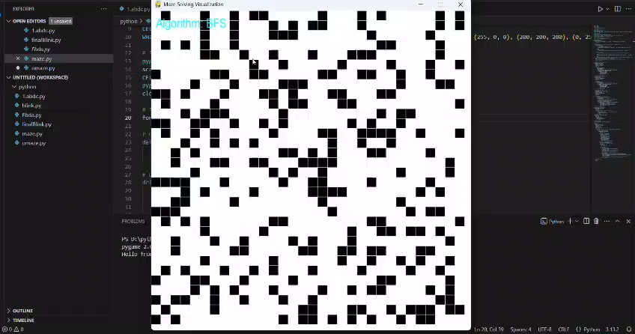

Slide 7
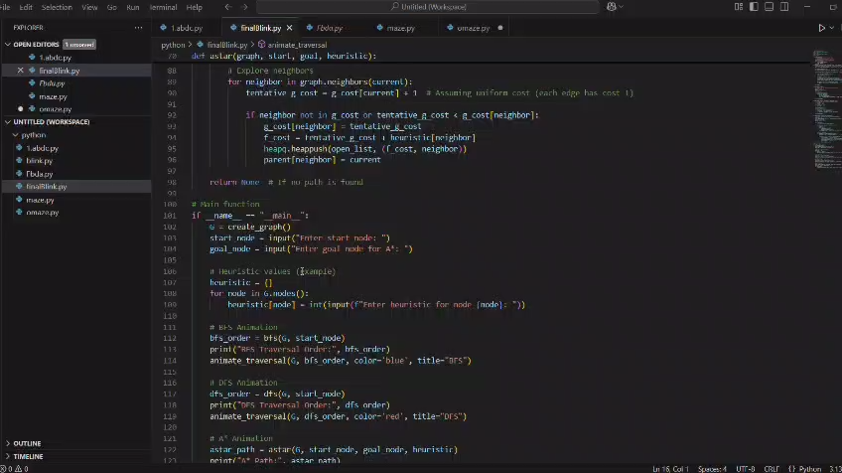

Slide 8
Technologies & Tools Used
🛠 Programming Language & Libraries:
Python 🐍 – Main programming language
Pygame 🎮 – For real-time visualization and interactive UI
NetworkX 🔗 – For graph creation and manipulation
Matplotlib 📊 – For graph traversal animation
💡 Why These Tools?
✔ Pygame enables smooth graphical representation and user interaction.
✔ NetworkX simplifies graph operations like edge creation and traversal.
✔ Matplotlib helps in step-by-step graph traversal animation.

Slide 9
Implementation Approach
1. Maze & Graph Generation
Random maze generation using a grid-based approach.
Graph creation using NetworkX based on user input.
2. Algorithm Implementation
BFS (Breadth-First Search): Explores nodes layer by layer.
DFS (Depth-First Search): Dives deep into one path before backtracking.
*A (A-Star Search)**: Uses a heuristic function for optimal pathfinding.
3. Real-Time Visualization
Pygame for step-by-step animation of maze solving.
Matplotlib for graph traversal animation.
4. User Interaction
Select start & goal points with mouse clicks.
Choose different algorithms via keyboard shortcuts.

Slide 10
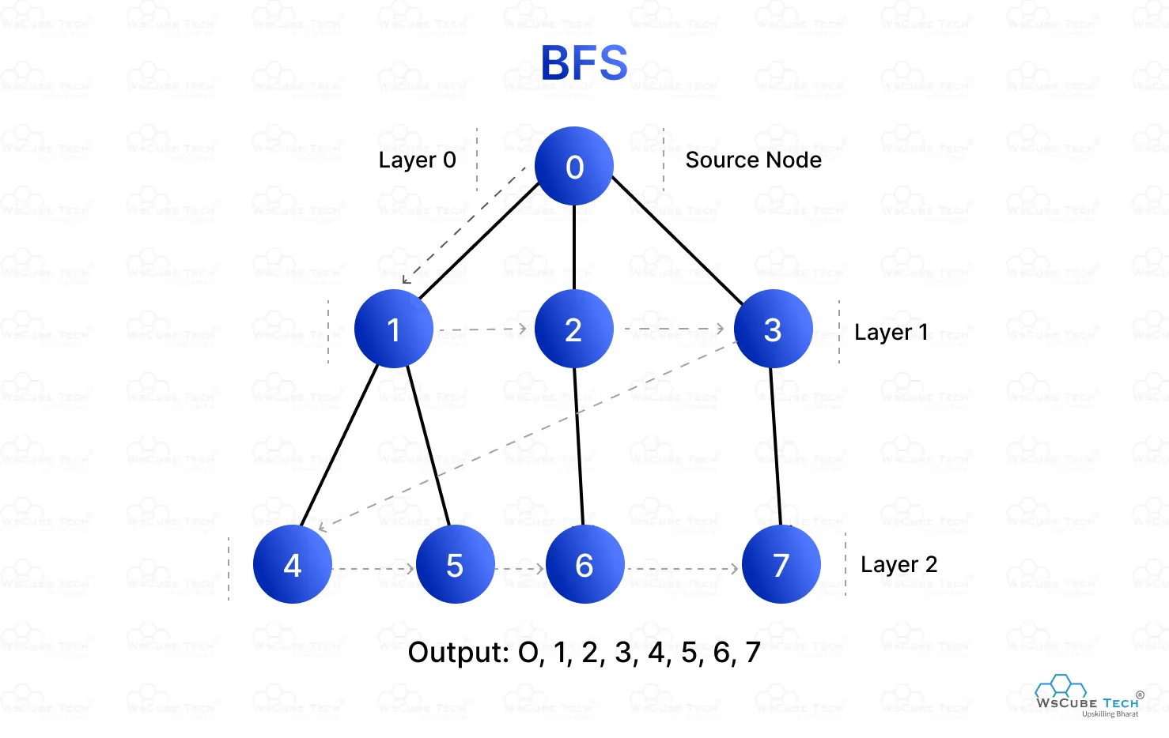

Breadth-First Search (BFS)
BFS explores nodes level by level using a queue (FIFO - First-In, First-Out). It starts by enqueuing the starting node, dequeues it for processing, checks if it’s the goal, and enqueues its unvisited neighbors. This process repeats until the queue is empty or the goal is found. BFS guarantees the shortest path in unweighted graphs and is widely used in network routing, social networks, and shortest pathfinding.

Slide 11
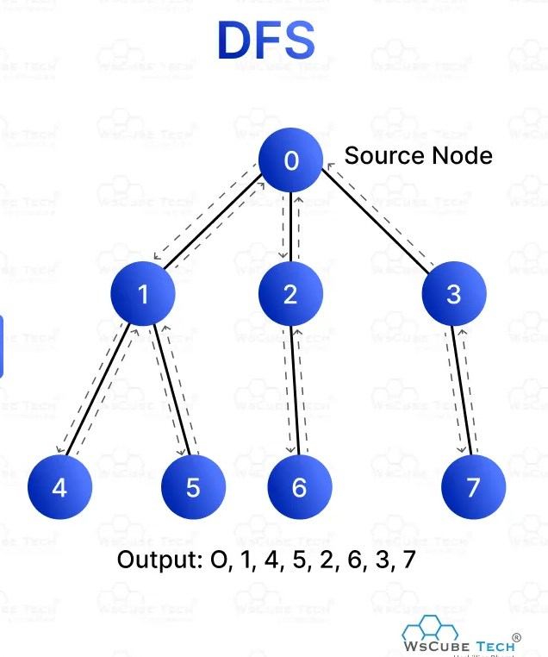
Depth-First Search (DFS)
DFS explores a path as deeply as possible before backtracking, using a stack (LIFO - Last-In, First-Out) or recursion. The algorithm pops the top node, checks if it’s the goal, and pushes its unvisited neighbors onto the stack. This continues until the stack is empty or the goal is reached. DFS is effective for maze solving, game puzzles, and tree traversals, but it does not guarantee the shortest path.

Slide 12
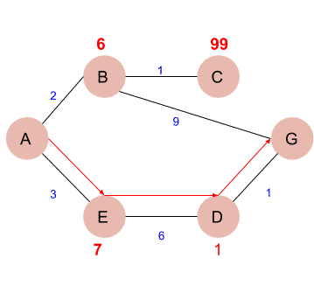
A* Algorithm
A* finds the shortest path in weighted graphs by combining BFS's exhaustive search with heuristics. It maintains a priority queue, selecting nodes with the lowest cost function f(n)=g(n)+h(n)f(n) = g(n) + h(n)f(n)=g(n)+h(n) (actual cost + estimated cost). It ensures the most optimal path and is widely used in AI, GPS navigation, and robotics.

Slide 13
Algorithm
Breadth-First Search
Depth-First Search
A-Star Algorithm
Start
↓
Initialize Stack
Push Start Node
↓
While Stack is not empty
↓
Pop Node
↓
Is Node the Goal?
↙ ↘
Yes No
End Get Neighbors
↓
Push Unvisited Neighbors to Stack
↓
Repeat
Start
↓
Initialize Open List (Priority Queue)
Add Start Node with f(n) = g(n) + h(n)
↓
While Open List is not empty
↓
Remove Node with Lowest f(n)
↓
Is Node the Goal?
↙ ↘
Yes No
End Get Neighbors
↓
Calculate g(n), h(n), f(n)
Add to Open List if Not Visited
↓
Repeat
Start
↓
Initialize Queue
Add Start Node
↓
While Queue is not empty
↓
Dequeue Node
↓
Is Node the Goal?
↙ ↘
Yes No
End Get Neighbors
↓
Add Unvisited Neighbors to Queue
↓
Repeat

Slide 14
Conclusion
BFS: Best for shortest path in unweighted graphs.
DFS: Best for exhaustive exploration.
A*: Best for optimal pathfinding with heuristics.
Future Work: Extend visualization for weighted graphs and real-world applications.

Slide 15
Thank you

